Slide 1




Notes:
*

Slide 2


UI ENGINEERING STUDIO
UI Engineering Studio. Day 3 Bootcamp: CSS

Slide 3


UI ENGINEERING STUDIO
Cascading Style Sheets
used for describing the presentation of a document written in a markup language like HTML. CSS is a cornerstone technology of the World Wide Web, alongside HTML and JavaScript.
- Wikipedia
Semantic vs format
Browser Flow
Selectors
Homework

Slide 4
UI ENGINEERING STUDIO
UI Boot Camp: CSS Interface
In computing, an interface is a shared boundary across which two or more separate components of a computer system exchange information. The exchange can be between software, computer hardware, peripheral devices, humans and combinations of these.
- Wikipedia

Slide 5
UI ENGINEERING STUDIO
UI Boot Camp: CSS
Semantic
adjective
adjective: semantic
relating to meaning in language or logic.
Format
noun
noun: format; plural noun: formats
the way in which something is arranged or set out.
the shape, size, and presentation of a book or periodical.
HTML
CSS

Slide 6
UI ENGINEERING STUDIO
UI Boot Camp: CSS Browser Flow
Semantic
HTML
CSS
Format
The CSS Object Model is a set of APIs allowing the manipulation of CSS from JavaScript. It is much like the DOM, but for the CSS rather than the HTML. It allows users to read and modify CSS style dynamically.
Parse
Loads
Parse
DOM
CSSOM
RENDER TREE
Render

Slide 7
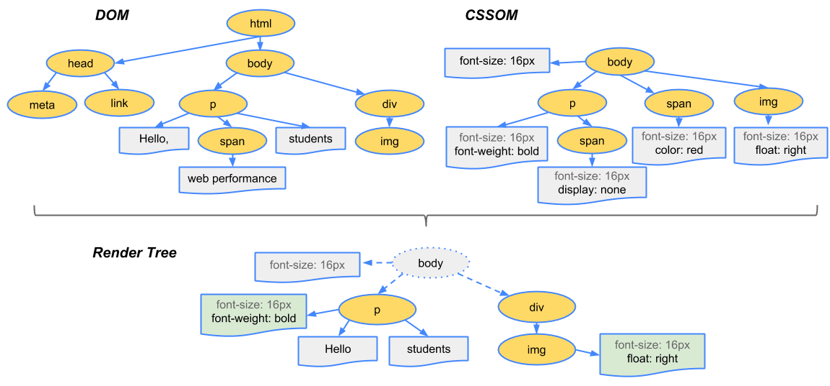
UI ENGINEERING STUDIO
UI Boot Camp: CSS Render Tree
Source: Google developers fundamentals

Slide 8
UI ENGINEERING STUDIO
UI Boot Camp: CSS Selectors
Declaration block
In CSS, selectors declare which part of the markup a style applies to by matching tags and attributes in the markup itself.
Consists of a list of declarations in braces.
Each declaration itself consists of a property, a colon :and a value.
If there are multiple declarations in a block, a semi-colon ; must be inserted to separate each declaration.
.exampleClass
#exampleID
div
:hover
CSS-selector {
CSS property : Value;
CSS property : Value;
}

Slide 9

UI ENGINEERING STUDIO
UI Boot Camp: CSS
Specificity
is the means by which browsers decide which CSS property values are the most relevant to an element and, therefore, will be applied.
1000
100
10
1
Inline Style
ID
Class
Attribute
Pseudo-class
Element
Pseudo-element
Notes:
Pseudo-element
p::first-letter {
color: #ff0000;
font-size: xx-large;
https://developer.mozilla.org/es/docs/Learn/CSS/Introduction_to_CSS/Pseudo-clases_y_pseudo-elementos
}

Slide 10
UI ENGINEERING STUDIO
UI Boot Camp: CSS
Specificity
div#user.container.selected {}
1 ID x 100 = 100
2 Classes x 10 = 20
1 Elements and pseudo-elements x 1 = 1
Total 121

Slide 11
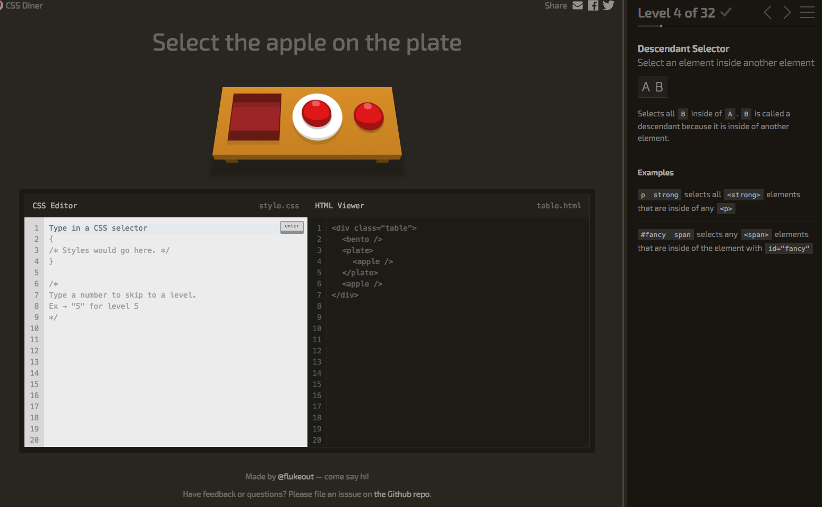
UI ENGINEERING STUDIO
UI Boot Camp: CSS Homework: CSS Dinner
https://flukeout.github.io/

Slide 12
Notes:
*

